Slide 1

Efficient Inventory Management System
Mentors
Mr.Vinod & Ms.Bhanupriya
Group Members
Shilpa Arnoliya
Aniket
Santosh Kulkarni
Swetha P.A.

Slide 2

Poor inventory management leads to a loss in sales which in turn paints an inaccurate picture of lower demand for certain items, making future order predictions based on that past data inherently inaccurate.
Business Problem:
Objective:
The objective is having efficient inventory management system, where in based on the provided data set, minimum inventory must be predicted with a buffer of 10% for the success of inventory system .

Slide 3
Project Flow
Introduction
Business Problem
Importing Libraries
Feature Engineering
Missing data
Removing Duplicates
Feature Selection & Model Building
Getting & Merging data
Data Exploration
Normalization of Features
Model Validation & Deployment

Slide 4
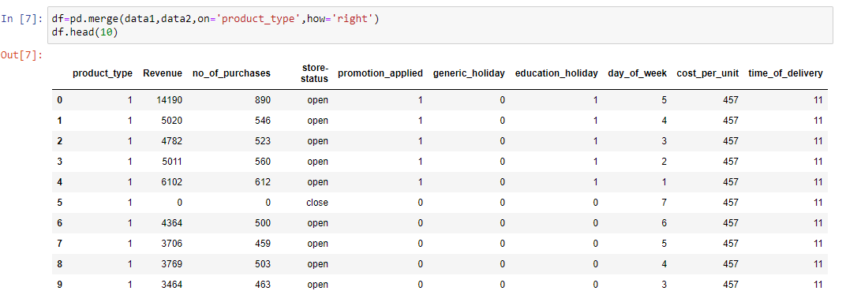
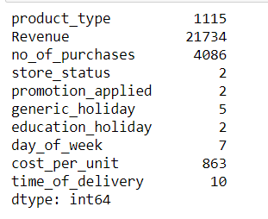
Data Exploration
Two data sets provided
Product Revenue Data
Product Detail Data
Datasets are merged based on unique column ‘Product type’ for analysis
Rows: 1017209
Features: 10
Categorical: 6
Numerical: 4
Unique Values

Slide 5


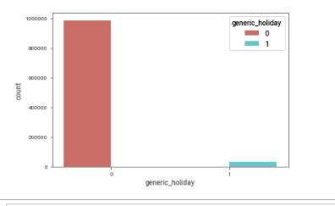
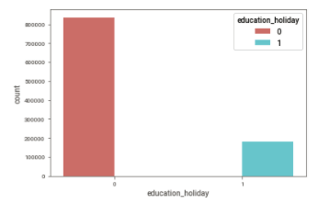
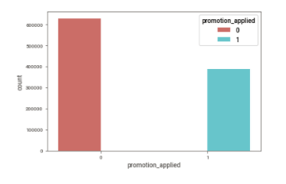

Data Vizualization
Generic Holidays
Education Holidays
Promotion Applied

Slide 6
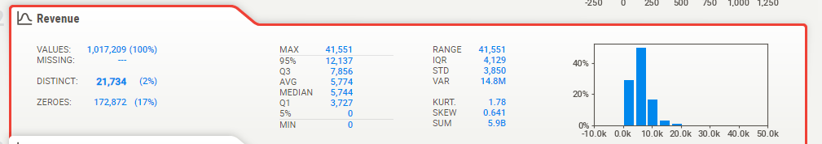
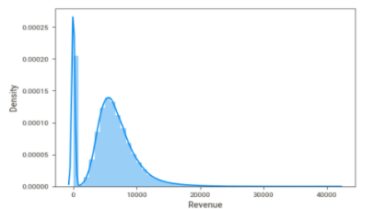
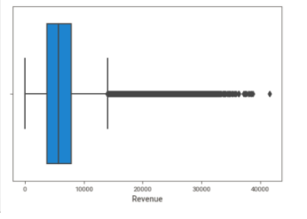
Data Vizualization - Sweetviz Library
Revenue

Slide 7
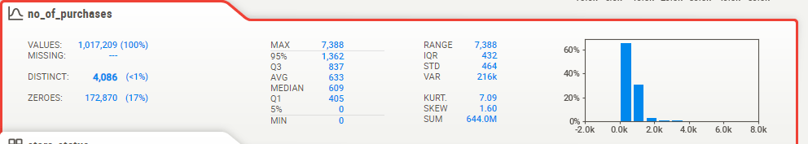
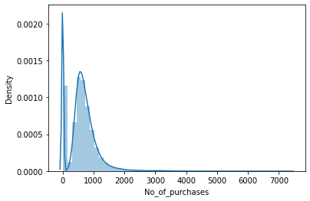
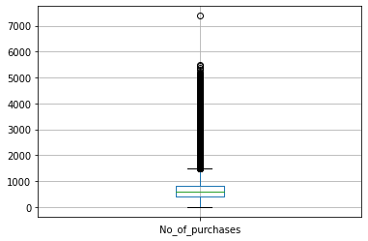
NO. OF PURCHASES

Slide 8
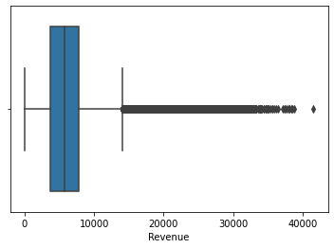
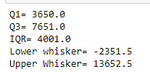
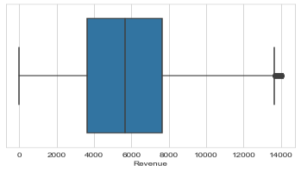
(
Feature Engineering
Outliers in Revenue Dataset
Converted Store Status from Object to Integer type
Store Open - 1
Store close – 2
Treatment of Outliers in Revenue Column
Interquartile Range Method is used
Data Shape after treatment for outliers
(990512, 12)
After removing Outliers in Revenue Dataset

Slide 9
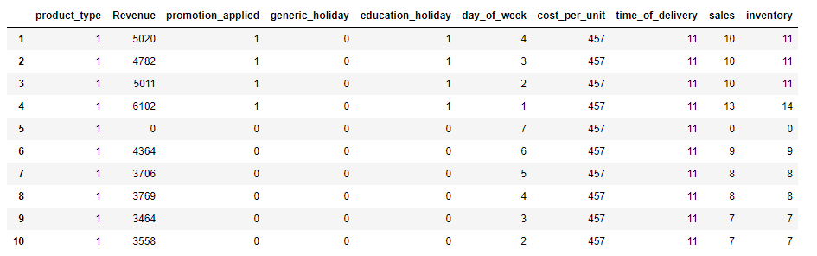
Feature Engineering
Column ‘ No. of Sales’ is created : No. of Sales = Revenue / CPU
Column ‘ Inventory’ is created : Inventory = No. of Sales +10 % Buffer

Slide 10
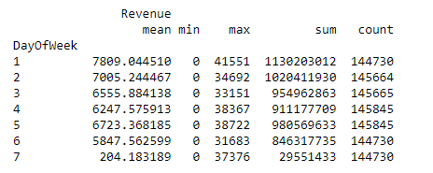
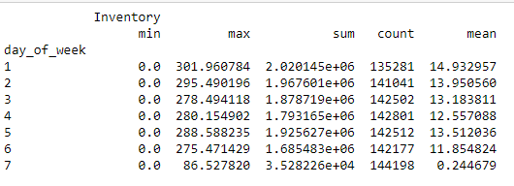
Aggregation of Values
The Revenue from sales on Day 1 i.e., Monday is highest with an average of 7809.04, followed by Tuesday with 7005.24 and so on.
Highest Revenue earned in on Monday 113,02,03,012.
The least sales is on Sunday with an average revenue of 204.18.
The Inventory on Day 1 i.e., Monday is maximum required with an average of 14.93, followed by Tuesday with 13.95 and so on which indicates that as inventory are required high during weekdays as compared to weekend.

Slide 11
Applying different models
Model | RMSE Values
Linear Regression | 0.2851
Logistic Regression | 2.2533
Decision Tree | 0.0522
Random Forest | 0.0593
Multilinear Model | 0.2854

Slide 12


Model Building
Model – Random Forest Regressor
Data set details:
with 3 columns, 2 predictors and target is ‘Inventory’
Algorithm details and configuration:
Random Forest algorithm with 200 trees with balanced data using Robust scaler
Data Partition details:
Train test split with 80% of data for training and 20% of data for testing
Test Accuracy : 99%

Slide 13
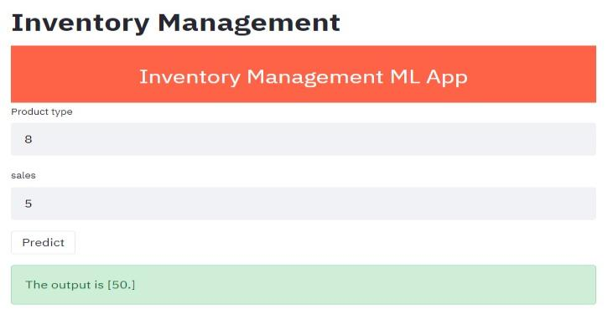

Model deployment
Model is deployed using Streamlit in Python.
Model can predict Inventory values based on ‘Product type’ and ‘Sales’
e.g.: Predicted value for ‘Product Type’ 8 and Sales on day 5 the available inventory: ‘50’

Slide 14
Challenges faced
Choosing the right combination of model using grid search.
Challenge was the time taken for the loop to check various combinations
How did you overcome?
We had to keep the system running for long hours

Slide 15
Thank you

